Slide 1

Genetic Analysis of Bacteria Using PCA
Kashish Kothari (202118011)
Pratik Patil (202118023)
Jeffrey James (202118031)
Tanya Jagyasi (202118039)

Slide 2
Index
Introduction
Data
Data Description
Data Pre-processing
Exploratory Data Analysis
Methodology
Mathematical Formulation
Experimental Results
Conclusion

Slide 3
Introduction
Bacteria Genetics is the study of composition, structure and inherited data present in the micro-organisms.
Some place where these bacteria are used are: medical industries, food and beverages industries, agricultural industries and many more.
In this project we will examine genetic information by applying Principal Components Analysis (PCA) and build a model that predicts and can classify species of bacterial.
3

Slide 4
Data Description:
We have chosen our data set from Kaggle.com
The data in this study is based on compressed DNA snippet measurements.
For example :
Using this method:
The DNA sequence ATATGGCCTT is translated to A2T4G2C2.
Where,
A - Adenine
T - Thymine
G - Guanine
C - Cytosine
4

Slide 5
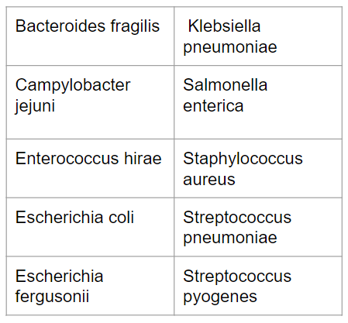
Dataset Description
The training set consists of 2,00,000 rows
and testing data set consists of 1,00,000 rows
across 10 different species which
becomes our target variable as stated here.
5

Slide 6

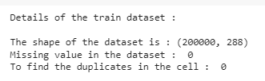
Data Pre-Processing:
We have checked for the null and duplicates Values using isna() and duplicated()
After checking out there are no duplicates and null values we move further to EDA.
6

Slide 7
Exploratory Data Analysis:
We have done few analysis of data set using:
Bar Graph
Corr plot
Highest Correlation of Species in their Gene
7

Slide 8
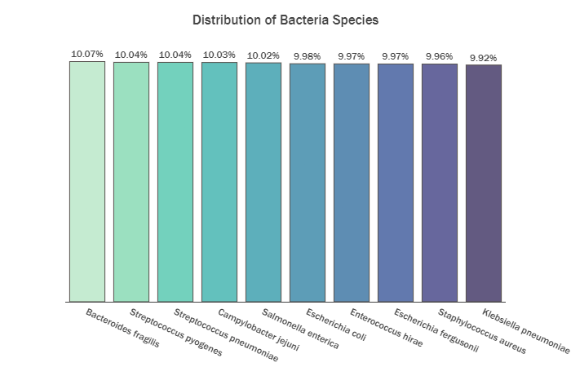
BAR PLOT
The bar graph shows that the
class distribution in our target
variable is evenly balanced
with 10 % of each species
represented in the data.
8

Slide 9
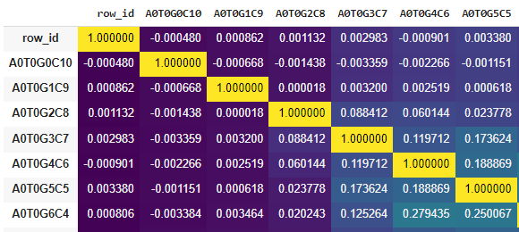
Corr plot
Corr plot of all the 286 columns are shown in the
Figure .Since there are lots of columns. Numerical representation is of no use.
Hence we have find out the
Highest positive correlated genes
9

Slide 10
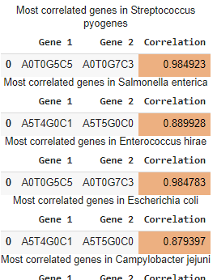
Highest Correlation of Species in their Gene
For every species we have
Calculated the highest correlation between the genes.
10

Slide 11
Transformation Applied
Since variables that are measured at different scales do not contribute equally to the model fitting & model learned function and might end up creating a bias. Hence we have to transform the data values.
Standardization:
Using sklearn Library importing StandardScaler.
Transforms the data such that its distribution will have a mean value of 0 and Standard Deviation of 1 (Standard Normal Distribution)
11

Slide 12
Methodology
Concept used: Principal Component Analysis
PCA is basically a statistical procedure which summarizes the content , that is reduce the dimensions of the dataset for better visualization, by preventing maximum variance and minimizing the loss of data.
Why PCA?
We can simply determine the association between observations using PCA.
Extracting the most important information from the data.
The most powerful use is that it helps in the reduction of data dimension by preserving crucial information.
12

Slide 13
Mathematical Formulation of PCA:
Steps used:
We first standardize the dataset.
Calculate the covariance matrix for features of the dataset.
Calc. eigenvalues
Sorting of eigenvalues in descending order
For every eigen values finding its corresponding eigen vector
Normalizing the eigen vectors
That is our PC1 and so on calculating for the rest of eigen values
13

Slide 14
Experimental Results
The genetic sequences A0T0G8C2 and A1T0G0C9 from Streptococcus Pneumoniae had the highest correlation coefficient of 0.995620.
The top 10 gene sequence pairs having the highest correlation coefficients were recognized that could be used to quickly predict the species of bacteria with high accuracy.
14

Slide 15
Conclusion
Applying PCA explores the data and sees how well the model would perform using a smaller set of variables.
In the 1st model for all the 286 genetic segments, we got an accuracy of 99.55%.
Further, we applied PCA and reduces the number of genetic segment to 100, then again we applied the model and got the accuracy of 99.25%.
Here, we can see that after applying PCA the accuracy score decreases, which might happen due to some data loss.
15

Slide 16
Thank You

